Slide 1
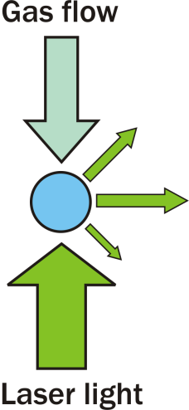
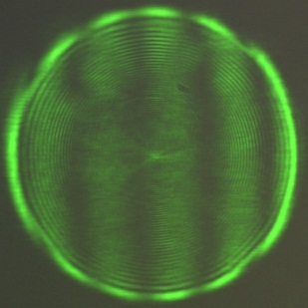
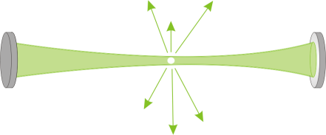
Techniques for probing fundamental aerosol properties
Phase function, σ_{geom}
Cavity ring-down spectroscopy, σ_{ext}
Radiation pressure, Q_{pr}
Mon 21st April 2014
Notes:
Explanation of ring down problems

Slide 2
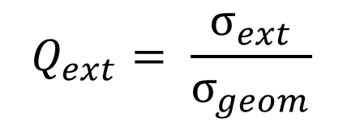
Optical extinction of aerosol particles
In atmosphere particulate extinction is dependent on many factors
Size and refractive index
Phase (separations, inclusions)
Morphology
$$Q_{ext}= \frac{σ_{ext}}{σ_{geom}}$$
Q_{ext} – Extinction efficiency
Experimental data of spherical and non-absorbing so scattering and extinction are analogous

Slide 3
Project aims
To develop and characterise the potential of experimental systems for measuring fundamental optical (and thermodynamic) properties
Ensemble cavity ring down spectroscopy for measurement of aerosol particles extinction cross-sections and refractive index retrieval – where are the limitations?
Develop a single particle cavity ring down spectrometer for measurement of aerosol extinction cross-sections.

Slide 4
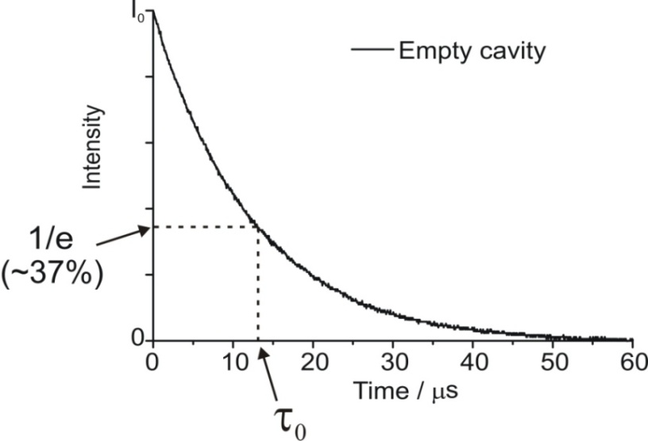
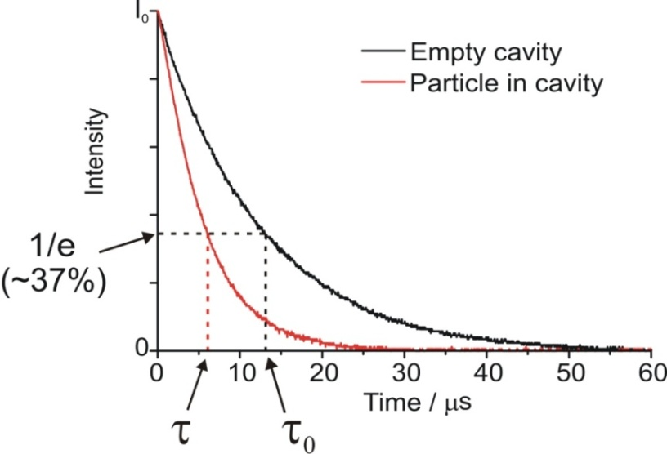
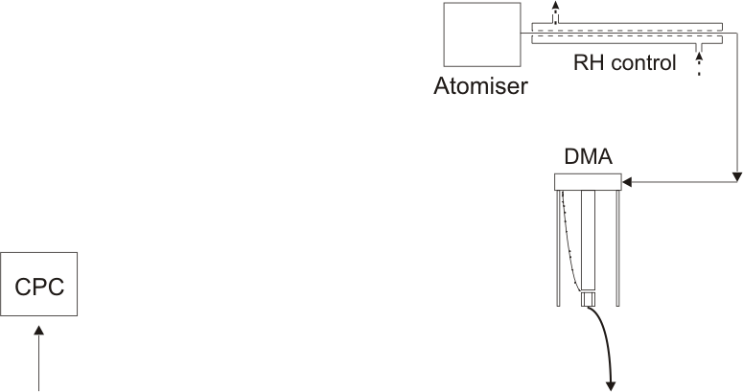
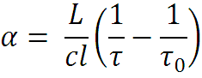
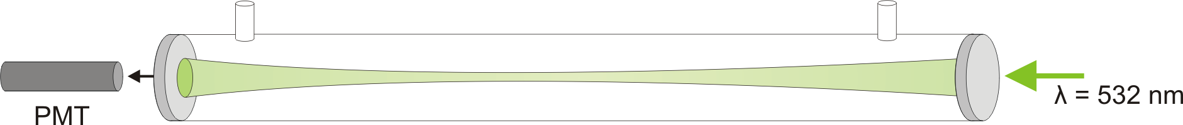
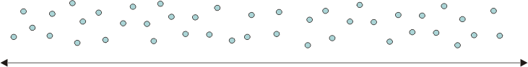
Ensemble cavity ring-down system
Filled cavity
l = L
L

Slide 5
Sodium nitrate aerosol
Interested in determining how well we can retrieve the RH dependent refractive index of a reasonably well characterised system
Tang, I. & Munkelwitz, J. Geophys. Res (1994)
Discrepancies in efflorescence relative humidity: between 47 % and 30 – 0.05 %
Lee, M.-J. et al. Atmos. Chem. Phys. Discuss (2011)
Compare the refractive indices with those determined using optical tweezers
Mason, B. J. et al. J. Phys. Chem (2012).

Slide 6
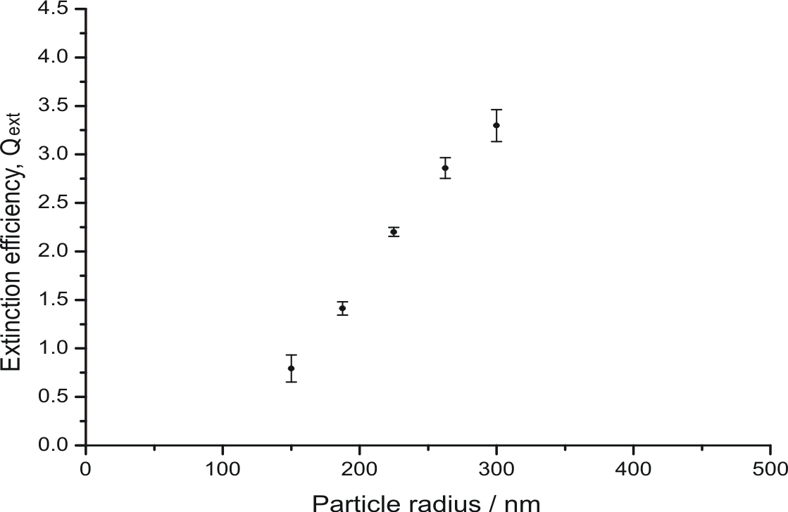
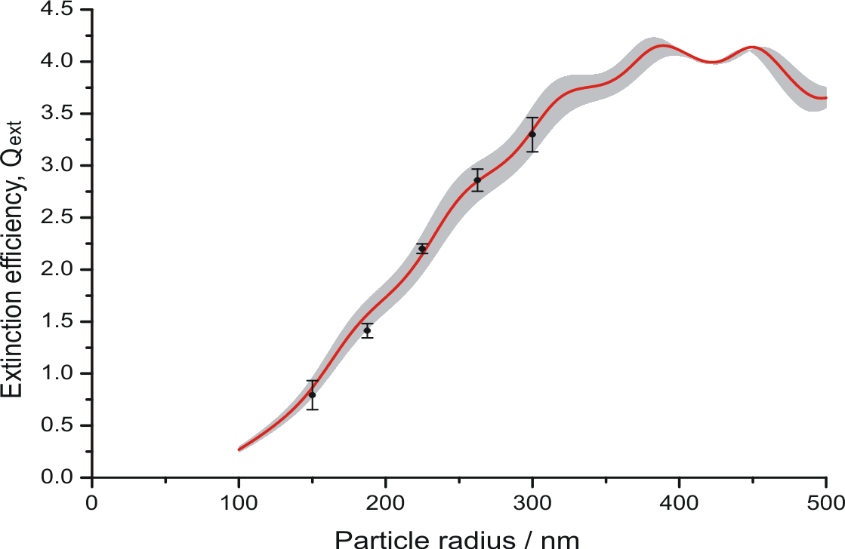
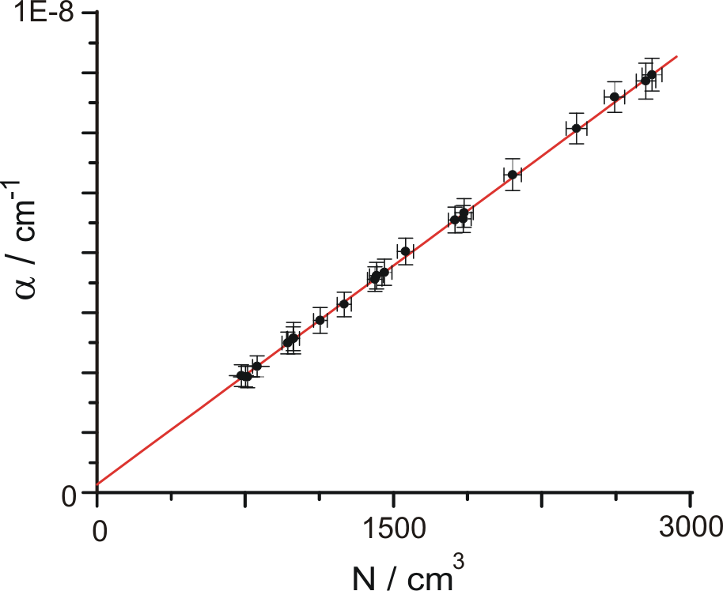
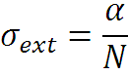
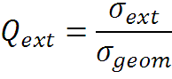
Ensemble CRDS – RI retrieval
NaNO₃ – 40 % RH
RI = 1.423 – Best fit Mie simulation
Shaded +/- 0.02
Miles, R. E. H., et al. Aerosol Sci. Technol. (2011)

Slide 7
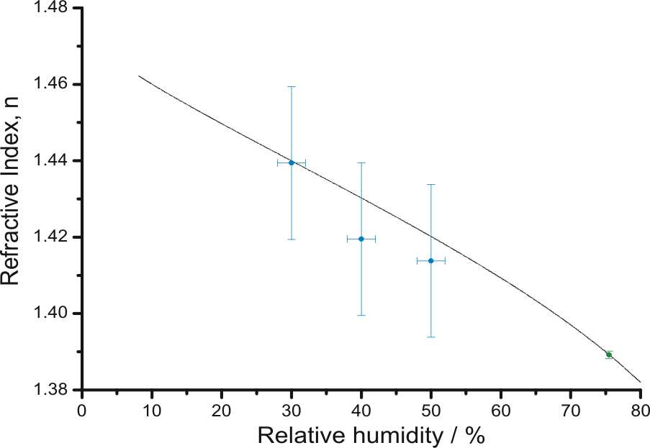
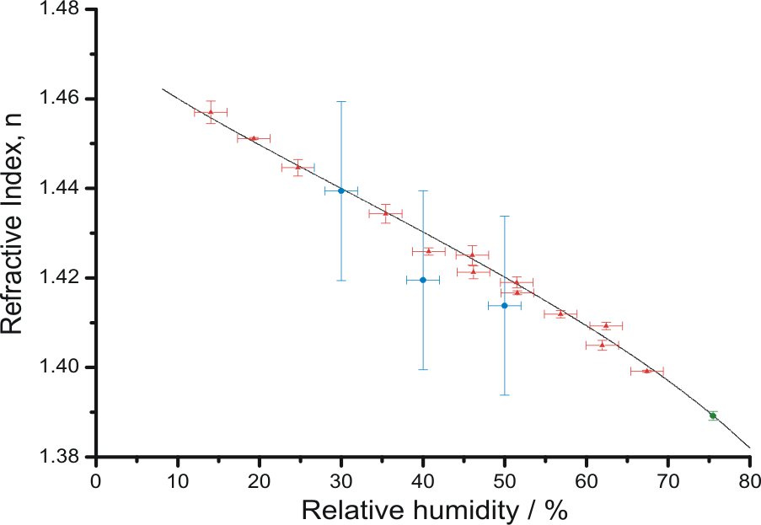
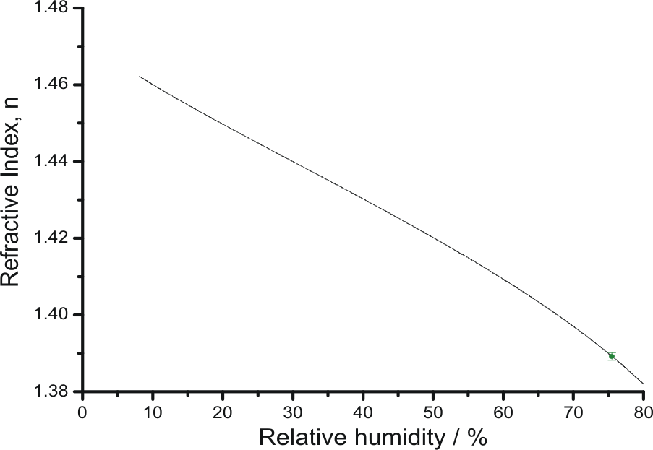
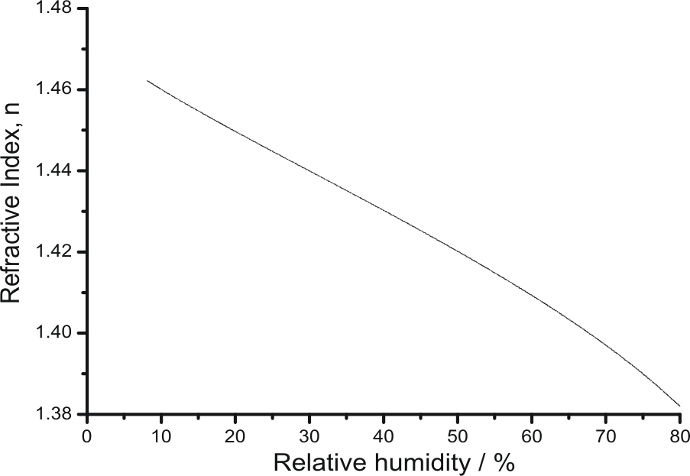
Ensemble vs single particle
Fit to electrodynamic balance – coarse mode [1]
Aqueous NaNO₃
Refractometer – bulk solution
Ensemble A-CRDS – accumulation mode [2]
Optical tweezers – coarse mode [2]

Slide 8
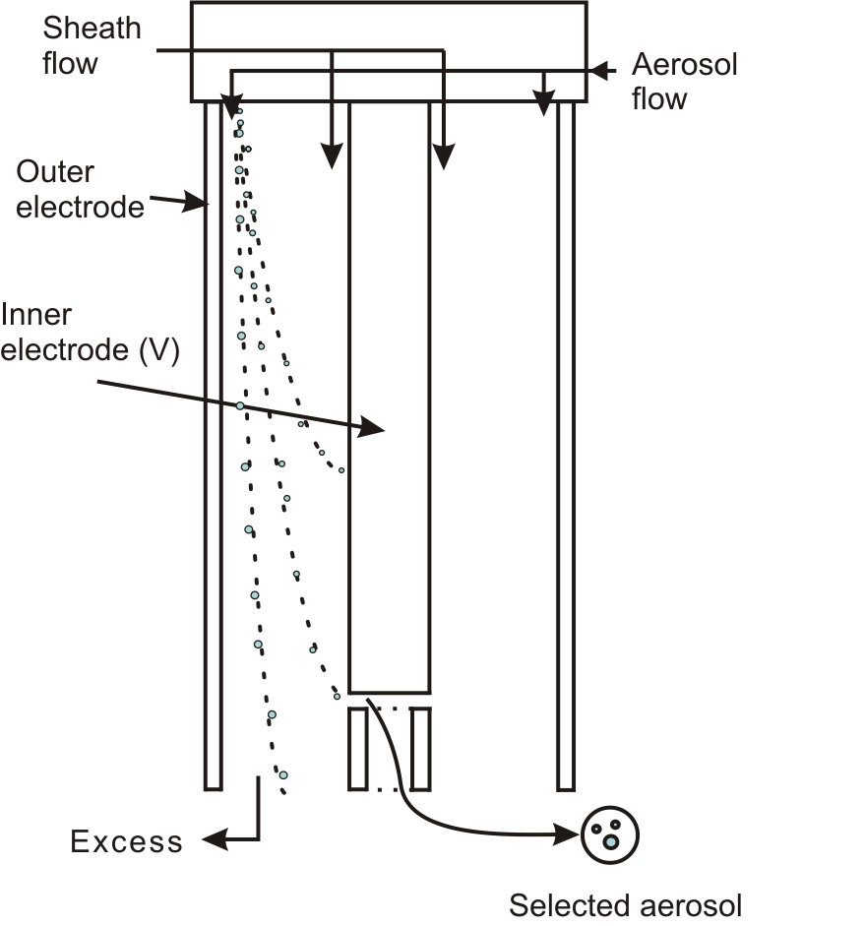
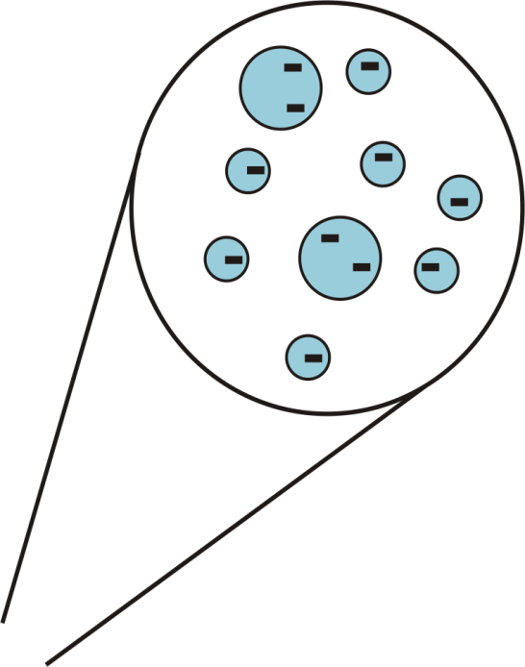
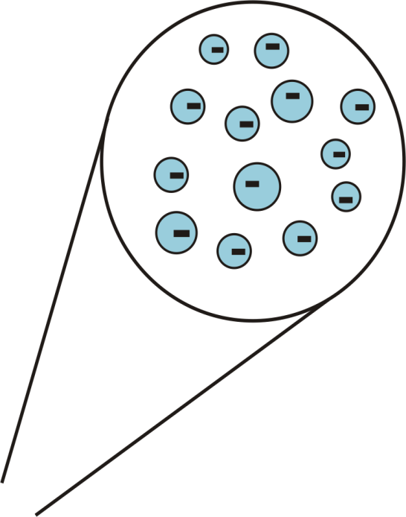
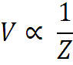
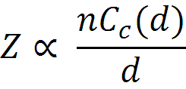
Differential Mobility Analyser - DMA
DMA
Size selects particles depending on the electrical mobility. The size distribution is dependent on:
DMA transfer function
Charge distribution imposed by the neutraliser
Pre-DMA size distribution

Slide 9
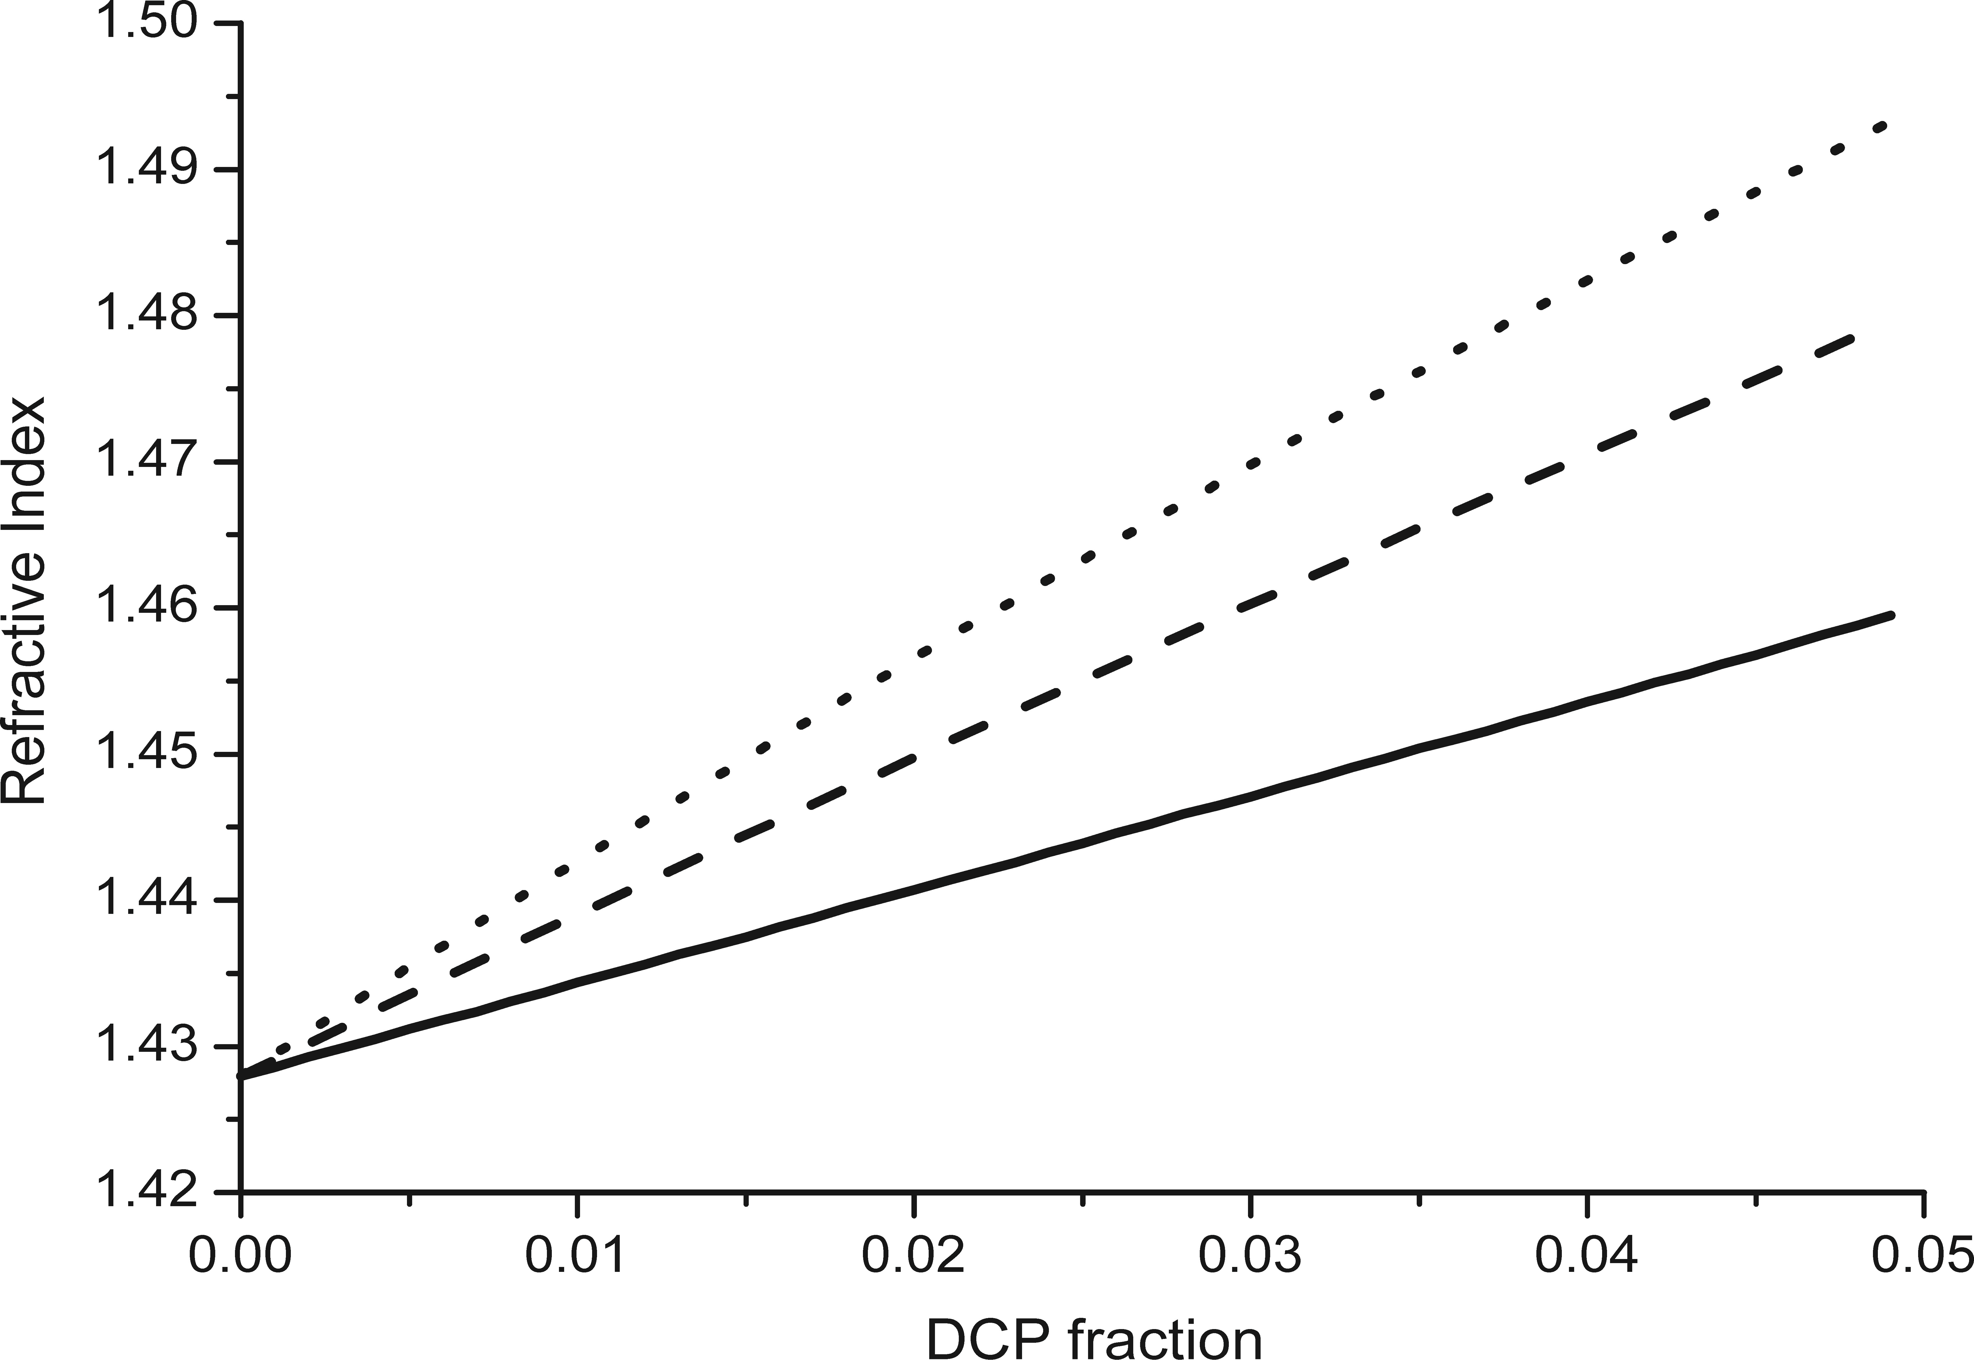
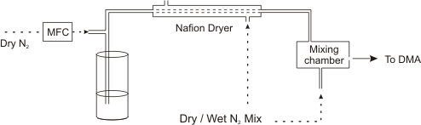
Effect of concentration on DCP fraction
150 nm dried to 55 % relative humidity. Liquid droplets.
Sodium chloride aerosol
(C)
(C) – 3.9 %
Varying the mixing gives a range of number densities.
(D) – 5.1 %
(D)
(B)
Varying the concentration of solution gives different extinction cross-sections
(B) – 2.2 %
(A)
(A) – 1.6 %

Slide 10
DMA – transfer function
DMA selection voltage = 2007 V
Transfer function amplitudes are arbitrary
n = 1
Assuming an ideal transfer function; no broadening
Notes:
Simulation of DMA transfer function in mobility and diameter space

Slide 11
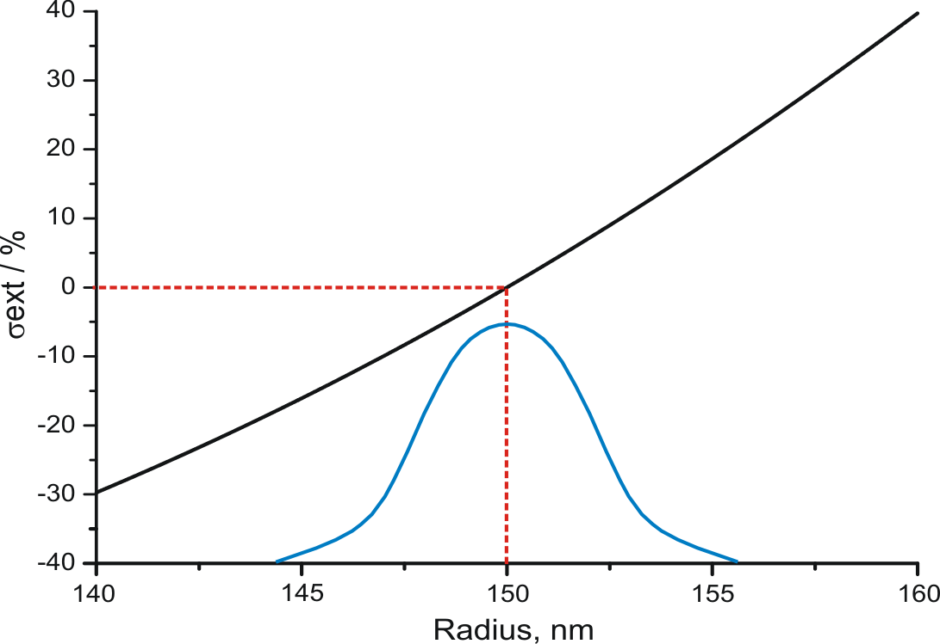
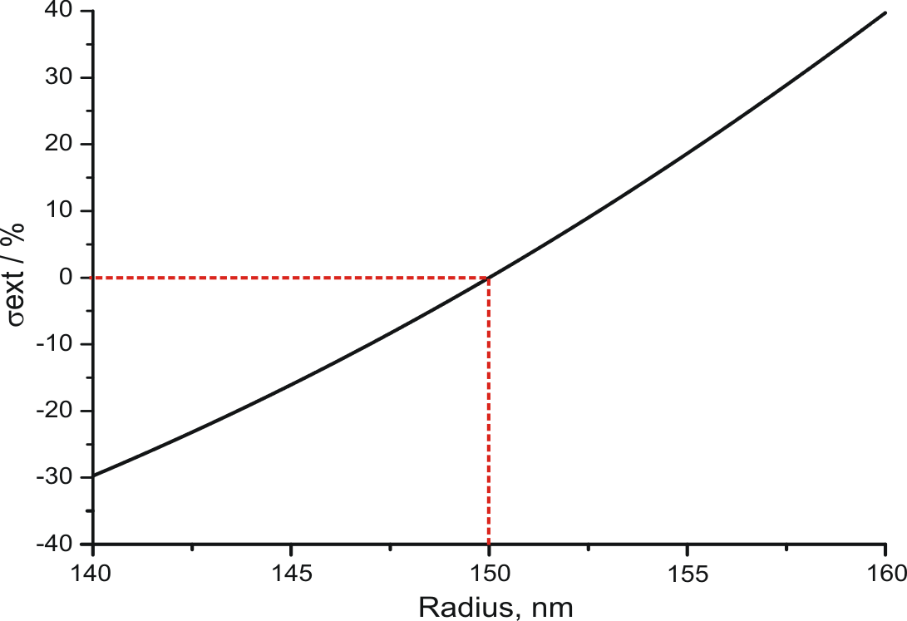
Ensemble A-CRDS uncertainty in radius
150 nm
Large variation in extinction cross-section with particle size.

Slide 12
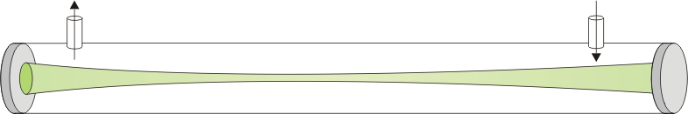
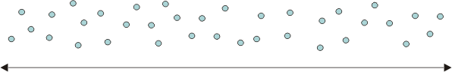
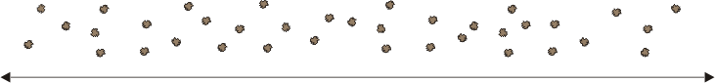
Ensemble A-CRDS uncertainty in radius
1. Multiply charged particles
1. Multiply charged particles
2. Particle modal size and size distribution
3. Particle morphology
l < L
l = L
4. Cavity length occupied by aerosols
Refractive index precision = ± 0.02
Notes:
Multiple charged particles – can be accounted for but contribute to the uncertainty.

Slide 13
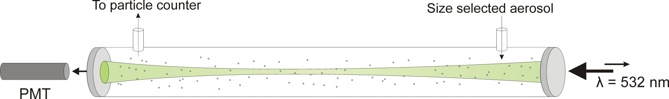
Ensemble cavity ring-down spectroscopy
Problems:
Uncertainty in the size distribution exiting the DMA
Uncertainty in the optical cross-section distribution
Uncertainty in length of the cavity occupied by aerosol particles
Sensitive measurement of particle extinction
Limited by knowledge of size distribution

Slide 14
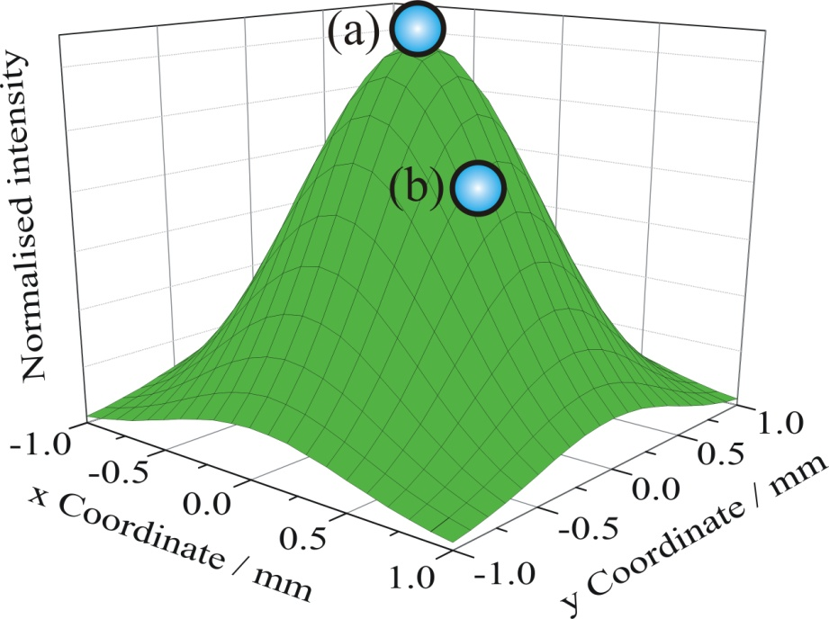
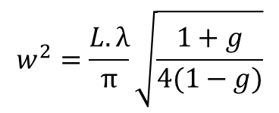
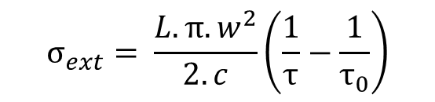
Single particle cavity ring-down system
$$σ_{ext}= \frac{L.π.w^{2}}{2.c}\left(\frac{1}{τ}−\frac{1}{τ_{0}}\right)$$
Removed uncertainties from ensemble technique
w – ring down event beam waist
Uncertainties:
Beam waist
Particle position
$$w_{}^{2}=\frac{L.λ}{π}\sqrt{\frac{1+g}{4(1−g)}}$$
It is important that we keep our particle in a fixed position!
1. Butler, T. J. a, Miller, J. L., & Orr-Ewing, A. J. (2007). The Journal of chemical physics, 126(17), 174302

Slide 15
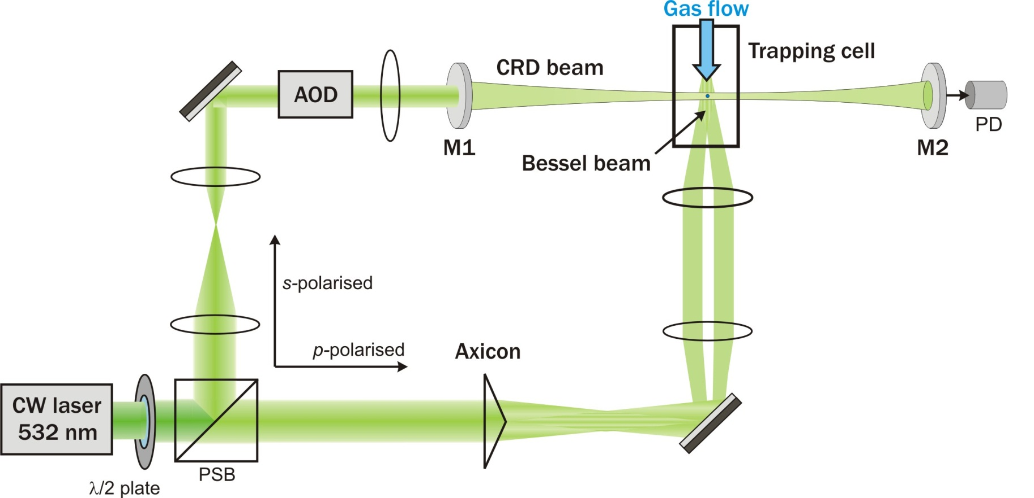
Cavity ring-down-Bessel beam system
In addition to the extinction cross-section we can probe:
1. The particle radius
2. The radiation pressure efficiency

Slide 16
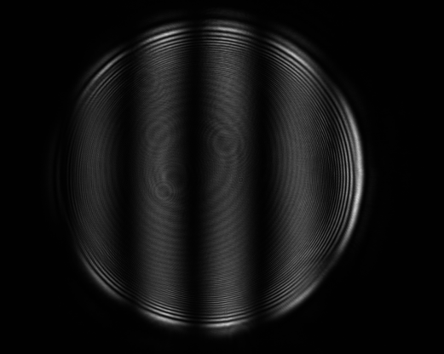
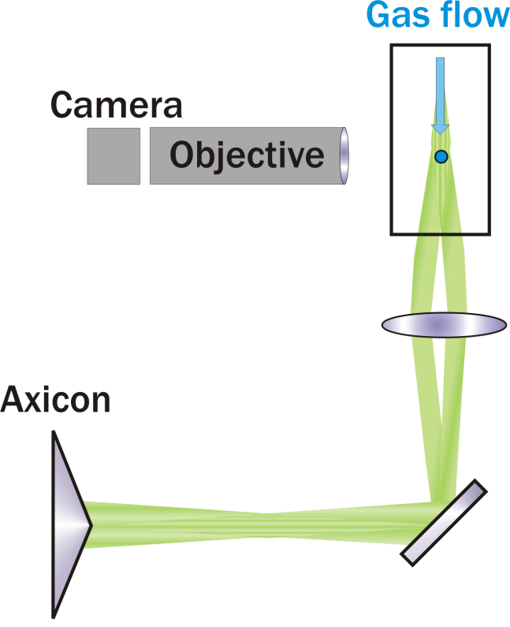
Cavity ring-down-Bessel beam system
Phase function
Elastically scattered light
Particle radius = 1314 nm

Slide 17

Cavity ring-down-Bessel beam system
Radiation pressure efficiency (Q_{pr})
Efficiency of momentum transfer by the incident beam due to angular dependence of scattering
Laser power required to keep particle at fixed height changes with size and refractive index
Can be compared qualitatively to laser power simulations
Notes:
As we’ve already shown light scattering has an angular dependence that is in turn dependent on the size and refractive index of particle. As such the momentum imparted by the incident beam changes as the particle changes in size meaning that the power required to keep it in a fixed position also changes. We therefore have to respond to the particles changing position by changing the laser power.

Slide 18
Cavity ring-down-Bessel beam system
Three measurements of particle scattering
Two advantages over conventional optical tweezers and electrodynamic balances
The ability to trap and probe smaller particles
The ability to get effective optical properties of the whole particle
First look at simple systems and compare with simulations
1,2,6-Hexanetriol - fixed refractive index
NaCl/H₂O
Ammonium sulphate/H₂0
changing refractive index with relative humidity
Notes:
Hexanetriol has a relatively low vapour pressure and will change size in a predictable manner with time.
NaCl is very well characterised, it should be possible to guess how the RI varies with size.
Important that we’re looking for agreement.

Slide 19
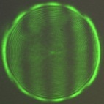
1,2,6 - Hexanetriol
Dry conditions - < 5 % RH RI = 1.480
Radius from phase function

Slide 20
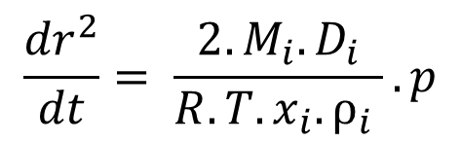
Hexanetriol – Vapour pressure
$$\frac{{dr}^{2}}{dt}= \frac{2.M_{i}.D_{i}}{R.T.x_{i}.ρ_{i} }.p$$
p = (5.58 ± 1.29)*10⁻⁴ Pa
p(EDB) = 2.27*10⁻⁴ Pa
p(OT) = 1.15*10⁻⁴ Pa

Slide 21
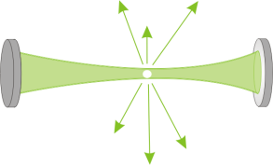
Hexanetriol – Particle extinction
1
4
1. Particle outside ring down events, τ₀ recorded
τ₀ ± s
Decreasing particle size
2. Particle brought into centre of ring down events, τ recorded
3
3. Particle evaporates
2
4. Particle falls out, τ₀ recorded
τ ± s

Slide 22
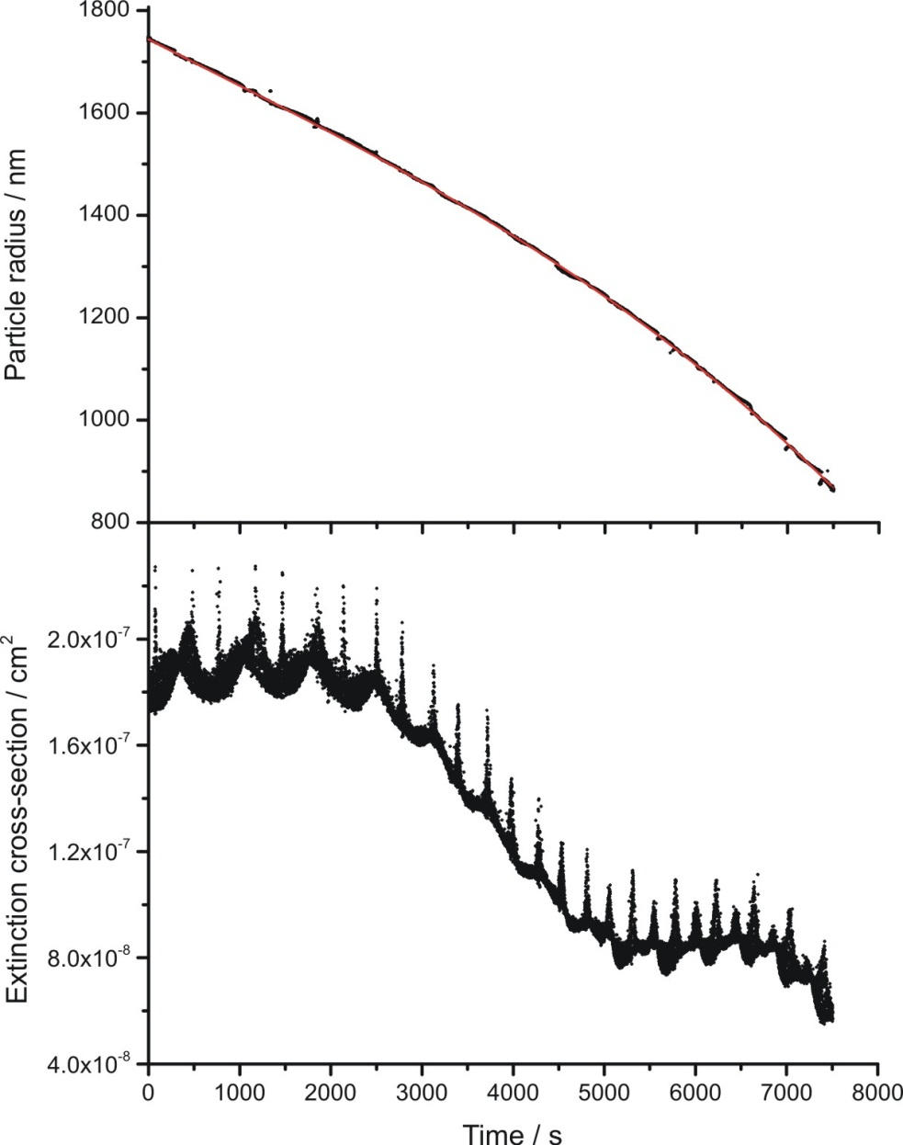
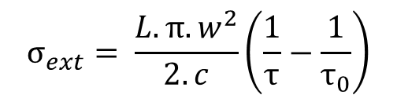
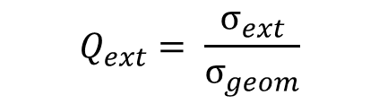
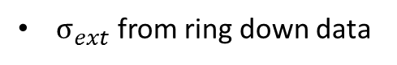
Hexanetriol - Particle extinction
Radius from phase function
Assuming a refractive index, n = 1.476
Particle radius / nm
$$σ_{ext}= \frac{L.π.w^{2}}{2.c}\left(\frac{1}{τ}−\frac{1}{τ_{0}}\right)$$
$σ_{ext}$ from ring down data
Extinction cross-section / cm⁻¹
$$Q_{ext}= \frac{σ_{ext}}{σ_{geom}}$$
Time / s

Slide 23
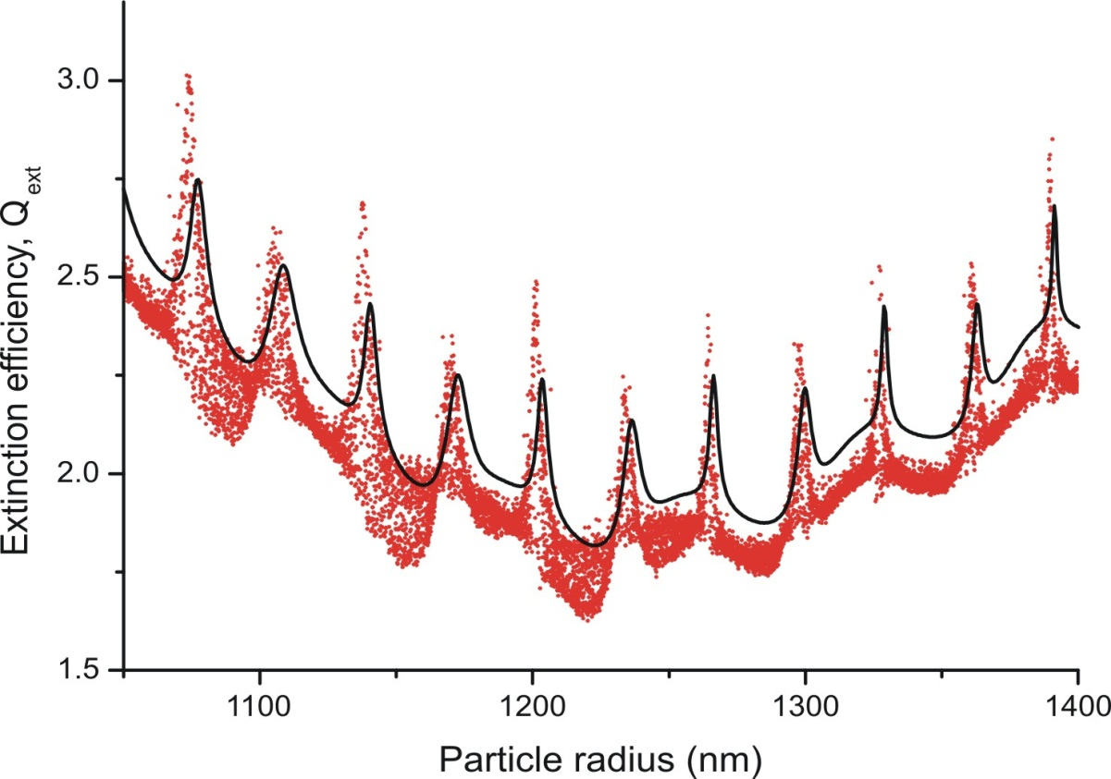
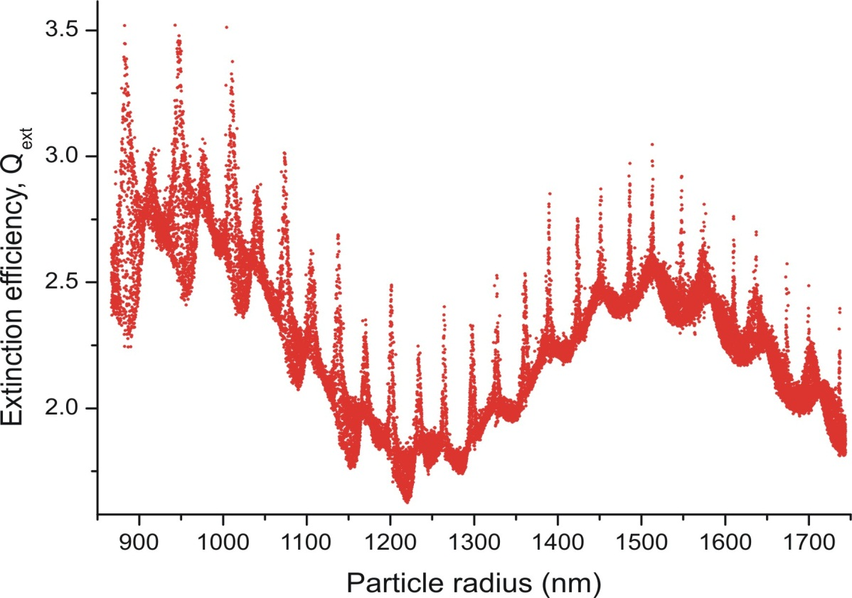
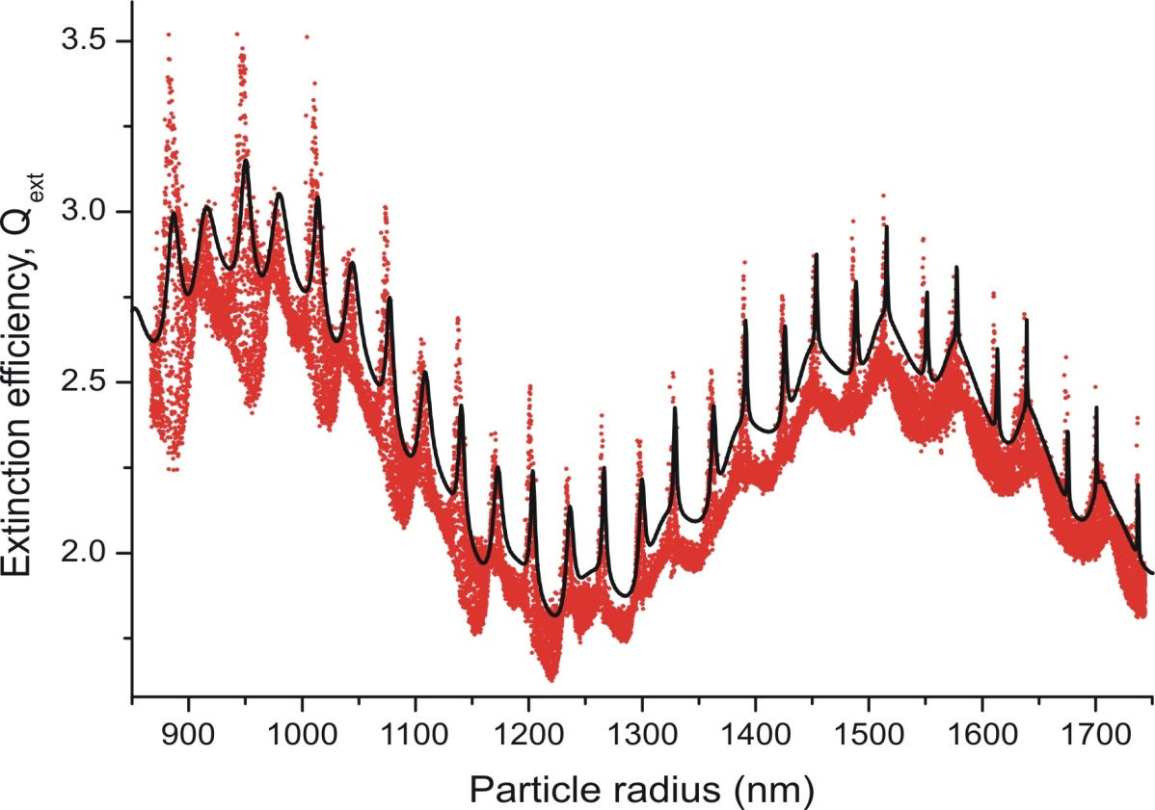
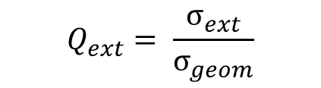
Hexanetriol - Extinction efficiency
$$Q_{ext}= \frac{σ_{ext}}{σ_{geom}}$$
Experimental data
Simulated data
RI = 1.476
Beam waist, w₀ = 270.9 μm
Why do we have an envelope in the extinction data?
Why do we have an offset between experimental and sims?

Slide 24
Extinction envelope
To explain the extinction envelope we must think of effect of the longitudinal, z, position of the particle on the amount of light scattered
z

Slide 25
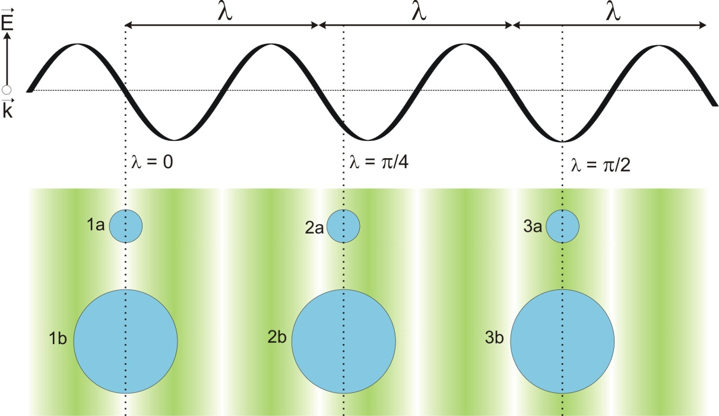
Extinction envelope
Consider a theoretical standing wave where the electric field only varies in the direction of the wave vector (z)
A particle introducing into this standing wave will cause light to be scattered and/or absorbed
The size and phase position of a particle within in the standing wave determines its overlap
How can this overlap be described?

Slide 26




The phase parameter
The phase parameter is used to describe this positional dependence
Node – thin line
Antinode – thick line
Plane wave – dashed line
$$σ_{ext}=\frac{σ}{ζ(z)}$$
$$Q_{ext}=\frac{σ}{ζ(z)σ_{geom}}$$

Slide 27


Extinction efficiency
$$Q_{ext}=\frac{σ}{ζ(z)σ_{geom}}$$
Experimental data
Simulated data
n_{D} = 1.476
Beam waist, w₀ = 270.9 μm
Why do we have an offset between experimental and sims?
Deviation of beam waist from ideal
Particle not central in ring down events
If the beam waist is not ideal can we fit it?

Slide 28

Hexanetriol - Extinction efficiency
Experimental data
Simulated data sets
RI = 1.476
Beam waist floated
The quality of fit is determined by the number of points that fall within the envelope
Our agreement after fitting the beam waist is much better, however no consideration of how the RI used in the phase function fitting may differ from the true RI

Slide 29



Hexanetriol – RI determination
Simulated data
RI and beam waist floated
The radius, r₁, from the phase function must be modified to account for each RI used in the fitting n₂
$$n1r1=n2r2$$
Notes:
As the particle becomes smaller it becomes harder to keep it in the centre of the ring down events leading to an increase in the spread of ring down times

Slide 30


Hexanetriol - Extinction efficiency
Fitted RI = 1.4775 ± 0.0004!
Beam waist = 278.85

Slide 31

Hexanetriol – Laser power
Indication of good estimation of refractive index
Qualitative only, but useful as a method of confirming radius retrieved from phase function
What about a system where the refractive index varies…

Slide 32


Slide 33
Sodium chloride/water – Radius
RH ~ 70 %
1st assumption: conc/RI at efflorescence RH is known
Size of particle at efflorescence determined
ERH ~ 45 %
2nd assumption: variation of conc/RI with radius known
Notes:
At the end I can explain why this isn’t physical.

Slide 35
Very sensitive measurement of extinction cross-section

Slide 36
Sodium chloride/water – Extinction
Agreement good but not as good as for single component
Highlights the uncertainty in the refractive index used to get the geometric cross-section

Slide 37

Sodium chloride/water – Laser Power
Similar offset as seen in extinction data
Harder to tell qualitatively whether the refractive index is correct
Notes:
Perhaps here we don’t have a qualitative way of confirming that the size we have is roughly correct.

Slide 38
Ammonium sulphate/Water
As with NaCl, offset in measured and sims suggests refractive index treatment is not perfect

Slide 39
AS/Water – Laser power

Slide 40
Take home message
Determining the radii of micron and sub-micron sized particles is hard.
Difficult to the level of precision we desire

Slide 41
Future Work
Bring all light scattering measurements together to determine both size and refractive index.
Better estimation of refractive index
Modification of the trapping cell for solid particles
Hexanetriol/ammonium sulphate particles. Liquid/liquid separation?

Slide 42
Sodium chloride/water – Radius
Particle radius/NaCl mass fraction varies as a function of RH
1st assumption: conc/RI at efflorescence RH is known
Size of particle at efflorescence determined
2nd assumption: variation of conc/RI with radius known

Slide 43

Glycerol study
Small offset possibly due to refractive index.

Slide 44
Ensemble cavity ring-down system
Particle Size selection with a DMA
Relatively large uncertainty in size distribution
Typical experiments are used to get a relative ‘optical growth’
Single particle technique eliminates the uncertainty of a size distribution. (BUT doesn’t eliminate the uncertainty in the size!).
Notes:
Directly pulling out a refractive index or scattering/absorption cross-section is difficult.

Slide 45
Hexanetriol study

